Slide 1
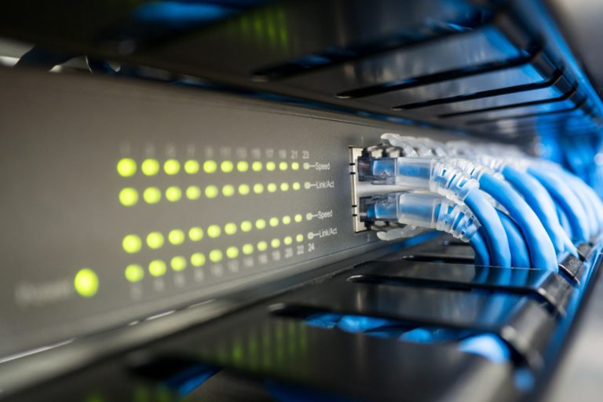

Lab #6
Enterprise LANs
Ethernet and Wi-Fi

Slide 2
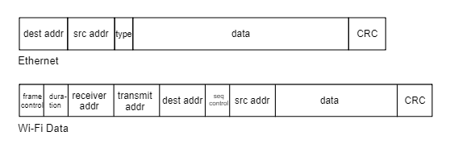
Ethernet and Wi-Fi Packets
While Ethernet and Wi-Fi share many characteristics, there are also several differences that impact network performance.
Wi-Fi frames have larger headers. Ethernet’s frame format is very concise. Wi-Fi frames are more complex because Wi-Fi is a more complex protocol. That means more frame overhead.
Wi-Fi requires frame acknowledgements. Since the airwaves used by Wi-Fi are unpredictable and vulnerable to transmission errors, every data frame sent by a Wi-Fi device must be acknowledged by the receiving device. That means more protocol overhead.
Wi-Fi systems use management frames. Wi-Fi AP’s broadcast beacon frames ten times per second for each SSID defined on the AP. Wi-Fi also uses other types of management frames to deliver wireless network services. That means more management frame overhead.
This diagram illustrates the simplicity of Ethernet’s frame format in comparison to Wi-Fi’s more complex frames.
Source: https://intronetworks.cs.luc.edu

Slide 3
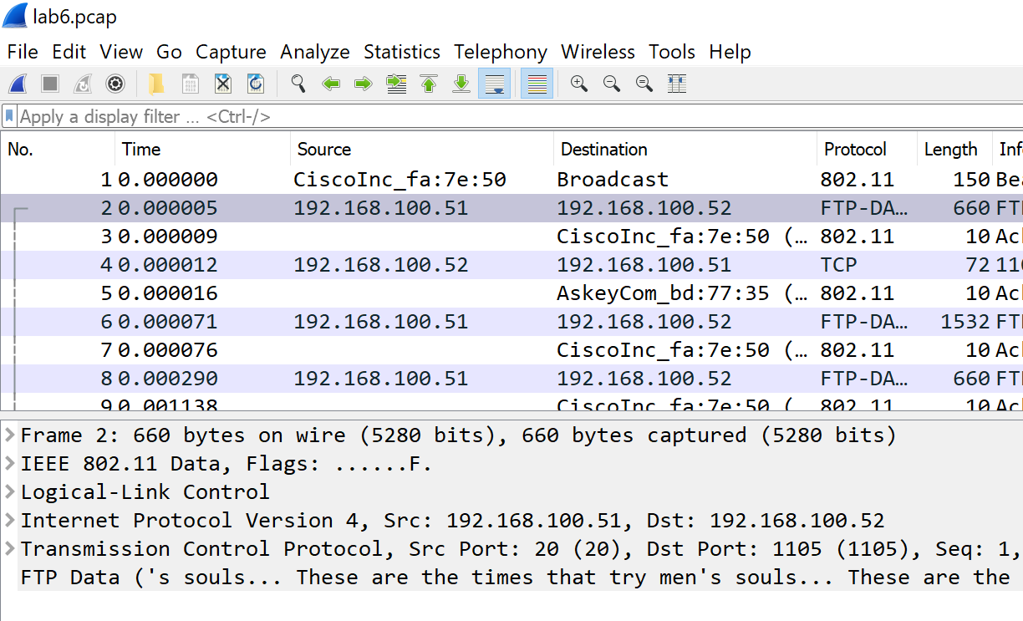
Wireshark Frame Analysis
Launch Wireshark and load the lab6.pcap file from Blackboard which you can find in the Lab folder for Learning Module 6. We will use this capture to illustrate the higher overhead of the Wi-Fi protocol.
Click on Frame 2, the first packet of an FTP file transfer between 192.168.100.51 and 192.168.100.52.
In the frame summary pane, you can see the network protocols being used for this file transfer. FTP uses TCP as a transport protocol and IP for host-to-host communication.
Now expand the IEEE 802.11 (Wi-Fi) frame headers by clicking on the arrow to the left of IEEE 802.11.

Slide 4
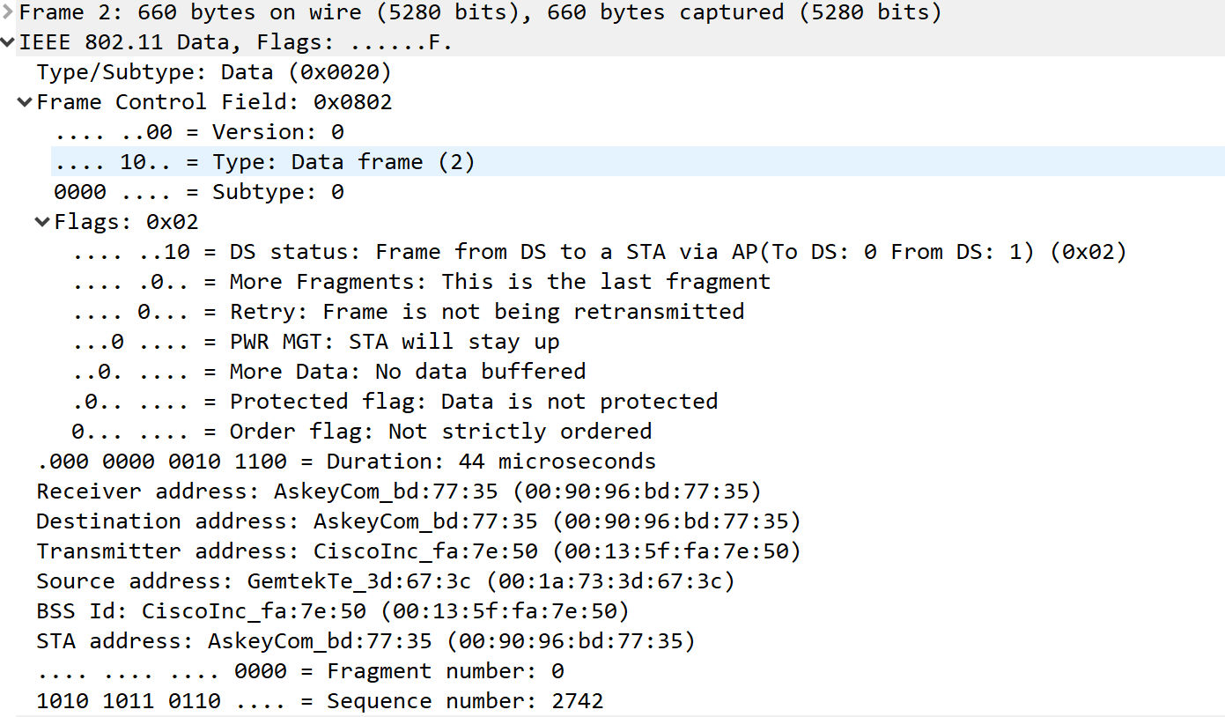
Wireshark Frame Analysis
Expand the Frame Control Field and the Flags field. Now you can see all the fields in a Wi-Fi frame. We won’t go into detail about the purpose of all these fields. The point we are making is there are lots of fields in the 802.11 frame header, resulting in more frame overhead than Ethernet.
Collapse the Frame Control and Flags fields to return to the frame summary view.

Slide 5
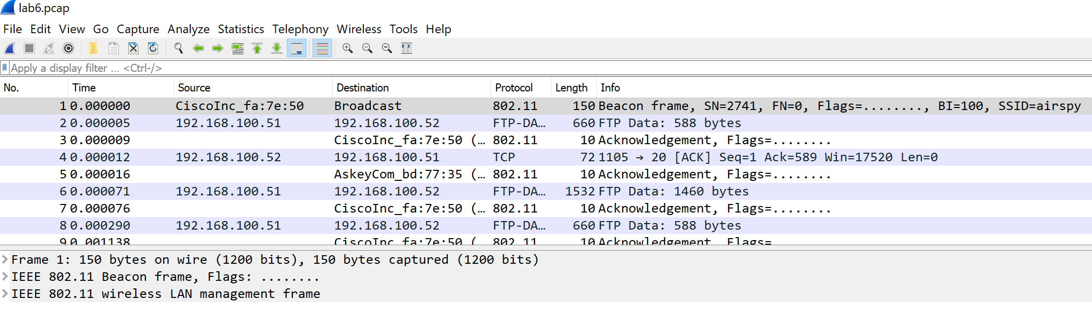
Wireshark Frame Analysis
Now, click on the first packet. This is an 802.11 management frame known as beacon used to advertise the services of AP’s. AP’s broadcast a beacon every 100 ms (10x per second) for every SSID configured on the AP. Your PC and smartphone listen to these beacons and use the information to generate a list of available Wi-Fi AP’s.
Note that beacons are one of many wireless LAN management frames used to facilitate and control access on a Wi-Fi network. Ethernet has no such thing, it doesn’t need it, just plug a cable into a port.

Slide 6
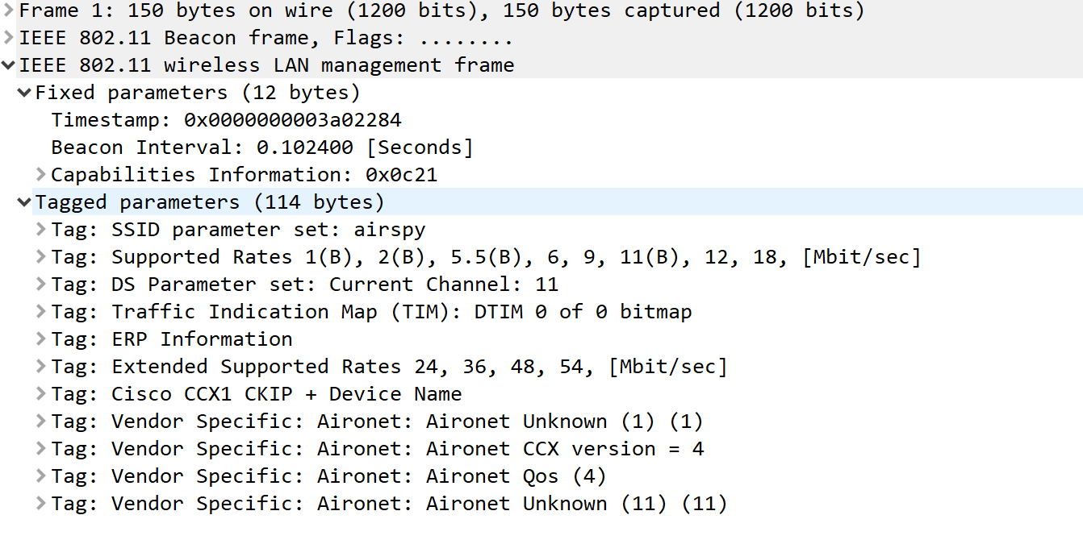
Wireshark Frame Analysis
Now, expand the 802.11 Wireless LAN Management frame. Then expand the Fixed parameters and Tagged parameters sections.
1
2
3
The tagged parameters fields contain information about the AP that is transmitting the beacon.
Note the first parameter, the SSID of the AP (airspy).
Note the radio channel being used for this SSID (11)
Note the extended supported rates. Because the AP is using Channel 11 (2.4 GHz band) and the maximum supported rate of 54 Mbps, we know that it is an 802.11g AP.
Now you know how Wi-Fi Inspector gathers information about available networks. You also know that management frames produce overhead on Wi-Fi networks.

Slide 7
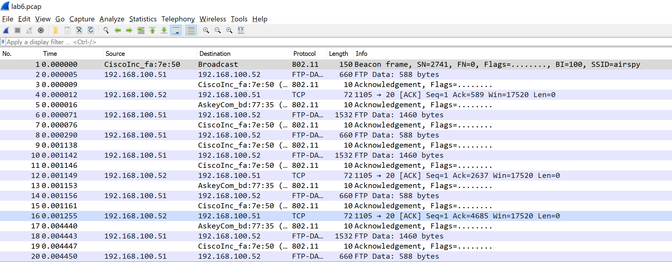
Wireshark Frame Analysis
Now, return to the Wireshark packet summary pane. You should be able to see the first 20 frames that are part of an FTP file exchange between 192.168.100.51 and 192.168.100.52.
Notice that for every frame transmitted (.51 to .52 and .52 back to .51), there is an acknowledgement frame. Ethernet has no such acknowledgment system because Ethernet incurs far fewer transmission errors compared to Wi-Fi.

Slide 8
Ethernet and Wi-Fi Packets
You should now have a better appreciation for the fact that IEEE 802.11 Wi-Fi has much more overhead than IEEE 802.3
Wi-Fi headers have additional fields. More overhead.
Wi-Fi requires frame acknowledgements. More overhead.
Wi-Fi systems use broadcast management frames. More overhead.
You can close Wireshark now.

Slide 9
Lab Check #1
Check you understanding!
Which frames are more complex – Ethernet or Wi-Fi? Why?
Which frames use acknowledgement packets? Why?
Why does Wi-Fi use beacons but not ethernet?

Slide 10
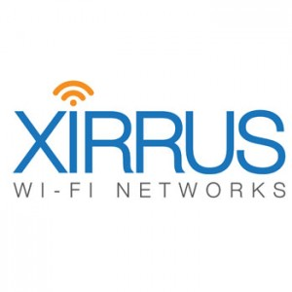
Installing Xirrus Wi-Fi Inspector
Note: Search for ‘Inspector’ app on your PC. Skip to slide 11 if ‘Wi-Fi Inspector’ is already installed.
Windows:
Go to Softwares folder on Blackboard in the Lab folder.
Click Here for Xirrus for Windows, it will take you to Google Drive.
Download both files from the Google Drive folder (setup.exe, Xirrus Wi-Fi Inspector.msi).
Once you have downloaded both files on your computer, run ‘setup.exe’ to begin installation. Click Run if it asks for any permissions.
The installation process is pretty simple. Just Click Next for 3 times and the software will be installed on your system. If you see a prompt for permissions, just say ‘Yes’.
Mac OS-X:
Go to Softwares folder on Blackboard in the Lab folder.
Download Xirrus for Mac OS from blackboard. A compressed zip file will be downloaded.
Open the folder and double click on Wi-Fi Inspector. If a pop-up is displayed reading:
“Wi-Fi Inspector” is an application downloaded from the Internet. Are you sure you want to open it?, click Yes.

Slide 11
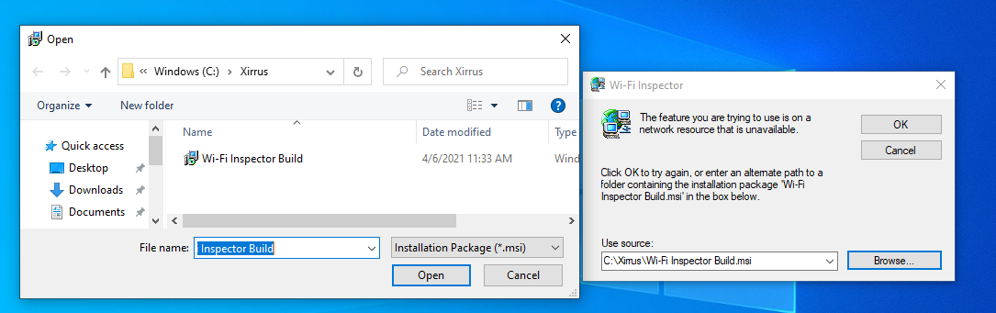
Launching Xirrus Wi-Fi Inspector
Click on Wi-Fi Inspector from Search menu
Click Browse and go to C:\Xirrus and select the .msi file there. If this dialog box does not appear, then move to the next slide.

Slide 12
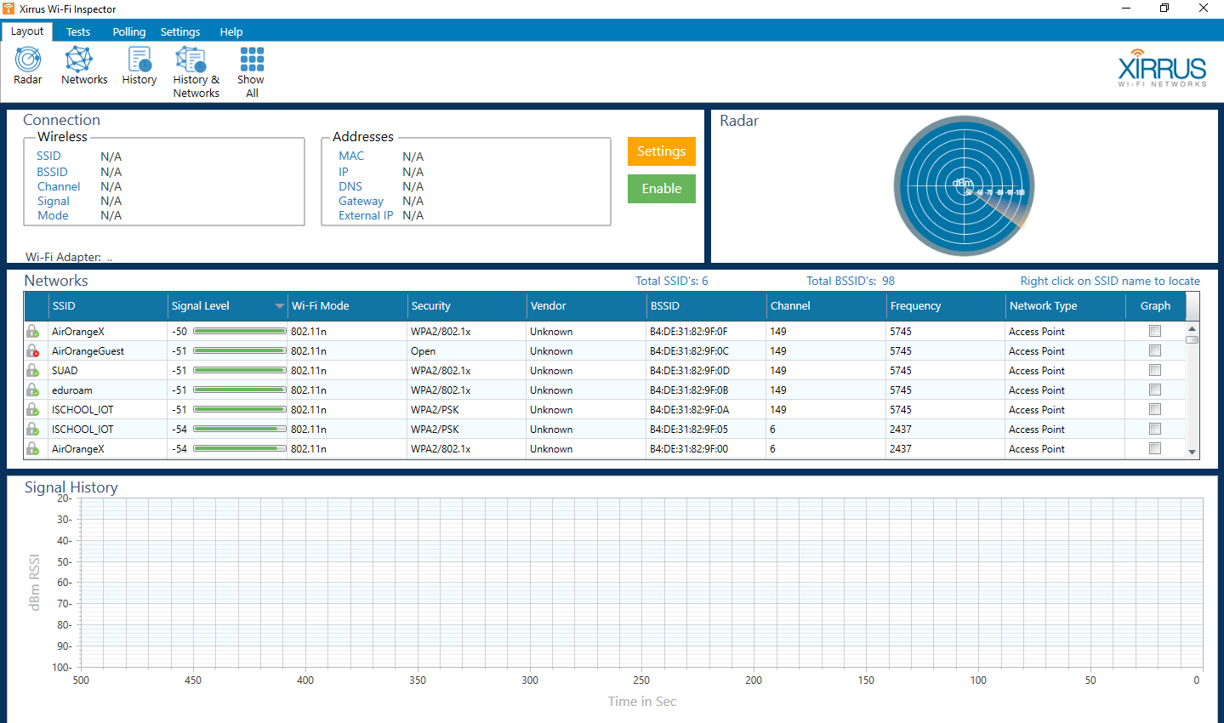
Launching Xirrus Wi-Fi Inspector
User Access Control Dialog opens.
Username and Password is displayed on the screen (look at the big TV screens in front of you)
Click Ok to launch Xirrus Wi-Fi Inspector.

Slide 13
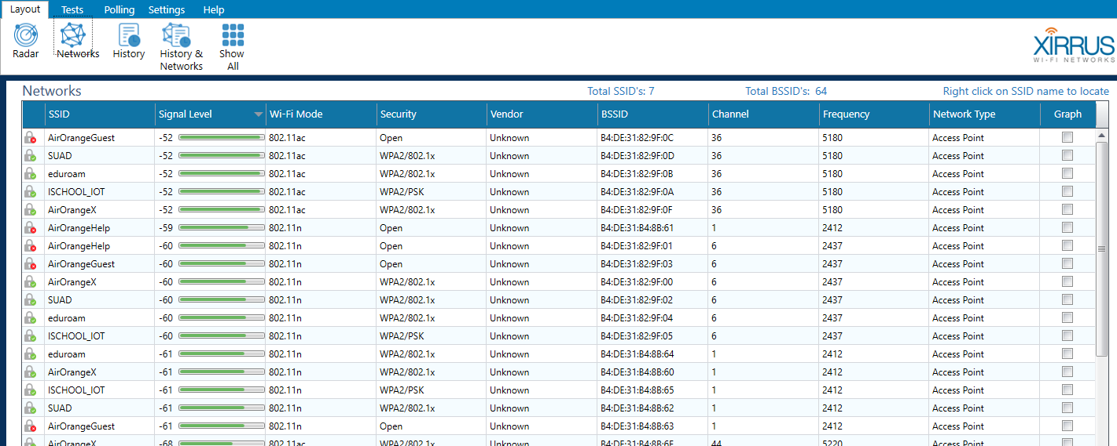
Analyzing Your Wi-Fi Network
Now, you will use Wi-Fi Inspector to scan your own Wi-Fi environment. The information displayed in Wi-Fi Inspector will vary depending on your physical location. Students completing this lab on campus will see a long list of networks that are part of the AirOrange campus network. Students completing this lab in a home or apartment will see their private Wi-Fi network as well as any other networks in close proximity.
Click on the Networks Icon below the Wi-Fi Inspector menu to display the Networks pane.

Slide 14
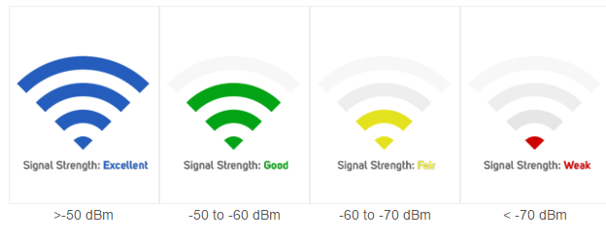
Receive Signal Levels: Decibels
Examine the Signal Level column in the Networks pane on Wi-Fi Inspector. You may be wondering why these decibel signals levels are represented as negative numbers. That’s a very good question!
You don’t need to know the math involved in converting watts to decibels (it’s called a logarithmic transformation), but you do need to know two things:
First, know that a receive signal level of 1 milliwatt is equal to 0 dBm. Yes, that sounds a little confusing, you might think 0 dBm means there is no signal, but in this case, 1=0. If 1 milliwatt = 0 dBm, that means that any received signal less than 1 milliwatt will be represented in dBm as a negative number. The higher the negative number, the weaker the signal. All dBm measurements are a fraction of a milliwatt, that’s what the “m” stands for, decibels relative to 1 milliwatt.
Second, you should know the following rules of thumb about Wi-Fi signal levels:
If the AP is in the same room as your computer, the received signal level will be about -30 to -40 dBm.
Enterprise network engineers design networks with overlapping cells such that clients should never see a signal below -65 dBm.
A signal level below -80 dBm will result in an inability to connect to the AP or intermittent disconnects.

Slide 15
Channels in Wi-Fi Inspector
Turn your focus back to Wi-Fi Inspector and examine the Channel and Frequency columns. The frequency column shows the center frequency for the channel displayed on that row. Focus your attention on the Channel column.
First, recall that the only available non-overlapping channels in the 2.4 GHz band are 1, 6, and 11. If you ever see a channel number between 1 and 11 that is not 1, 6, or 11, you have a potential problem. When a channel other than 1,6, or 11 is used, you are vulnerable to a nasty form of interference known as adjacent channel interference. Note in the figure below that the Bains network is configured to use Channel 2. Bob Bain is a good dentist, but he didn’t take IST 233! But there’s some good news to report. Since their signal level is very low, it won’t have much impact on other networks running on Channels 1 and 6, even though the channels overlap. Just like you can ignore whispers across a large room, AP’s can also ignore very low signal levels.
Second, note the 5GHz channels used on this network. When Wi-Fi Inspector lists two channels (149 and 153), that means a specific SSID is using channel bonding to combine 2 20 MHz channels into a single 40 MHz channel.
If you are wondering why so many SSIDs are using the same channel, the answer is that the network shown is a Google Wi-Fi mesh network, which has some advanced features.

Slide 16
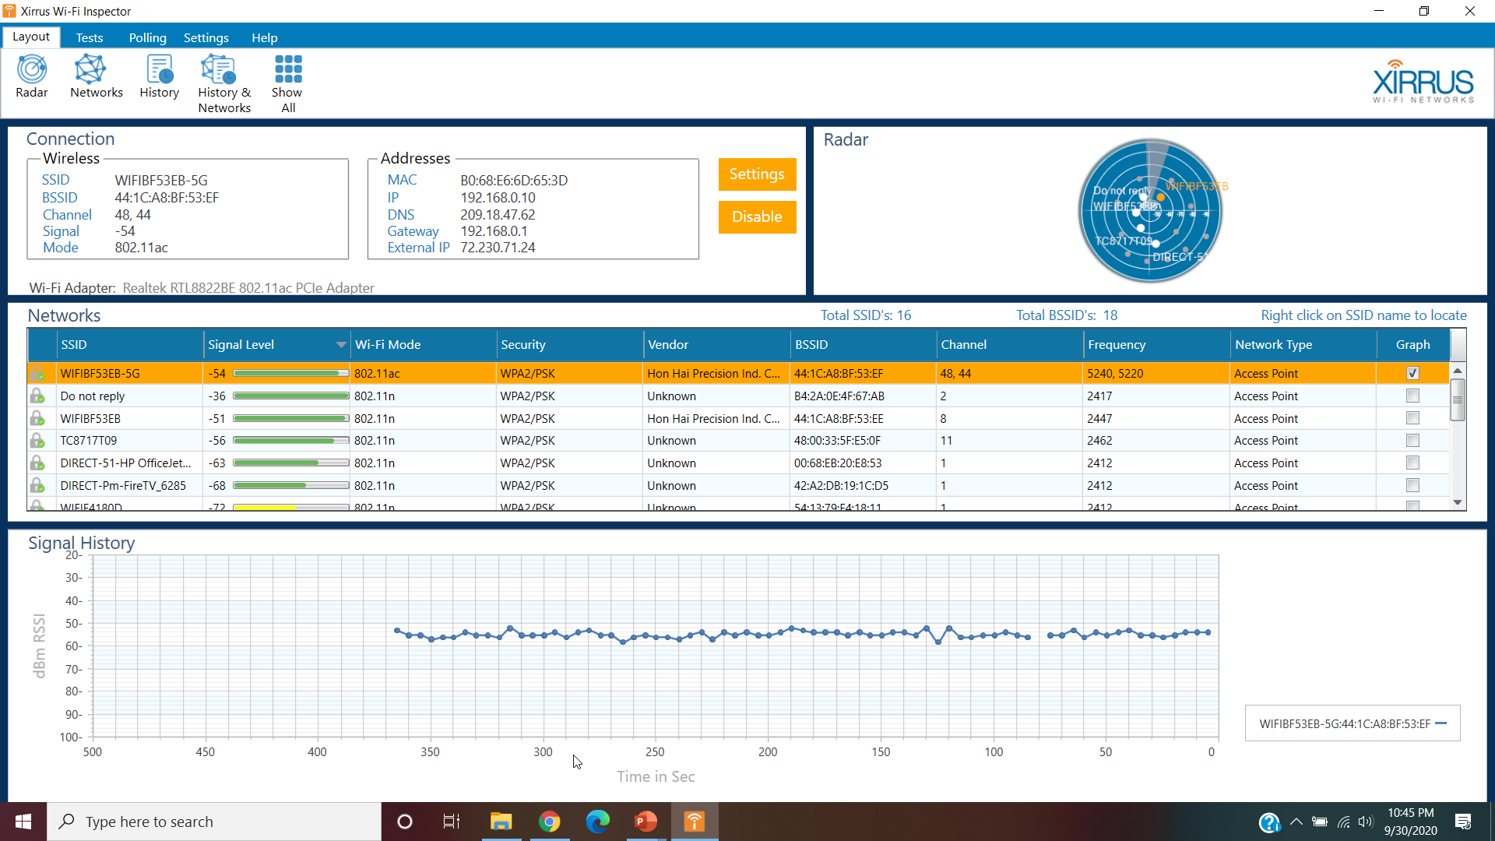
Analyzing Your Wi-Fi Network
Click on Show All (if already not selected)
Open Notepad and answer these questions:
What channel is used by the SSID you are connected to?
What is the signal strength of the SSID you are connected to?
What is the Wi-Fi Mode used by the SSID you are connected to?
For the top 4 SSIDs, mention the frequency band used by each of them (2.4 GHz or 5 GHz)
Write two advantages of using 5 GHz over 2.4 GHz.
Write two advantages of using 2.4 GHz over 5 GHz.

Slide 17
Lab Check #2
Report your progress to one of the TAs.

Slide 18
Ethernet Speed Test
When compared to Wi-Fi, Ethernet has very low protocol overhead. There aren't as many header fields as possible in Ethernet frames, and unlike Wi-Fi, transmitted frames do not require acknowledgements (ACKs) from the receiver. Because Ethernet overhead is so low, we expect application throughput (e.g., the speed you can transfer a file) to be fairly close to its data rate (aka, rated speed).
In this lab, Your goal is to perform a throughput test using Tamosoft TT and use the results to calculate the efficiency of Ethernet, what is sometimes called the Throughput-to-Data Rate ratio. The reason we use Tamosoft TT rather than Speedtest is because TT allows us to conduct controlled and repeatable tests of LAN performance without having to worry about Internet congestion.

Slide 19
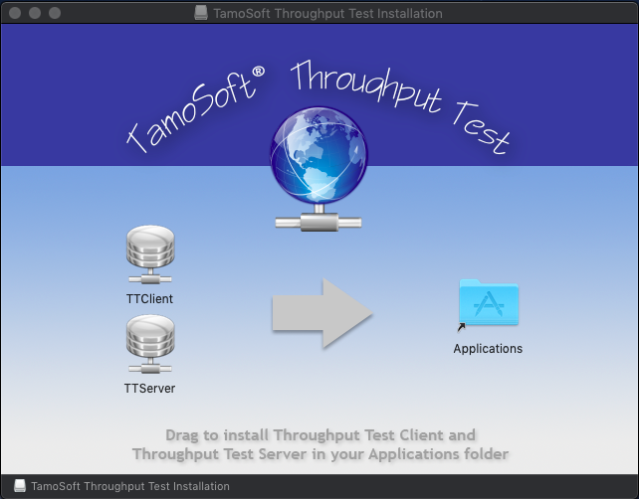
Installing TT: Windows and Mac
Note: Go to C:\Program Files(x86)\TamoSoft. If this folder exists, skip to slide 20.
Windows:
Download the Zip file from Blackboard’s Softwares folder and extract it. You can extract it by right-clicking the file and selecting Extract here.
Open setup.exe. Click Yes if it asks for any permissions.
Click Next, and then Accept the terms in the next window.
Click Next three times to finish installation.
Mac OS:
Click Here for Tamosoft Throughput Test Mac OS X. It will take you to a Google Drive link.
Then click Download.
Open Tamosoft TT for OS X.dmg from your downloads.
Click Agree in the dialog box that pops up.
Now drag both TT Client and TT Server into the Applications folder.
Once that is done, you can find the software in the Applications folder named as TTClient and TTServer.
DRAG
Notes:
http://www.tamos.com/docs/tt1.pdf

Slide 20
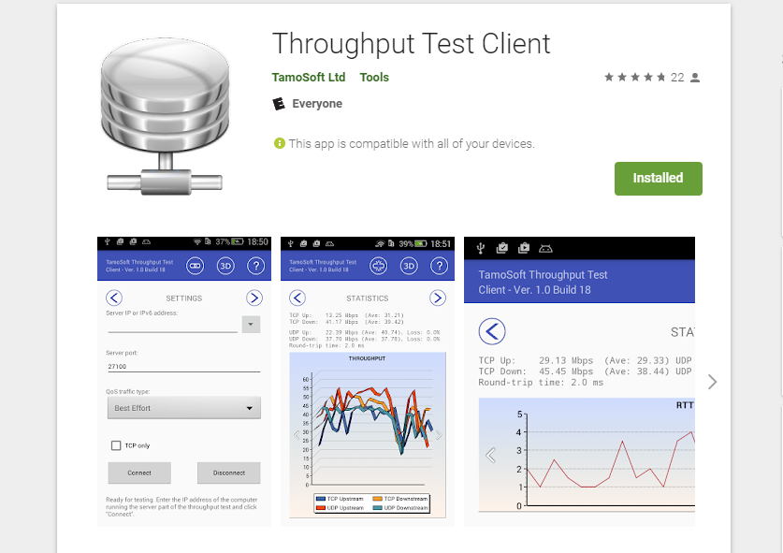
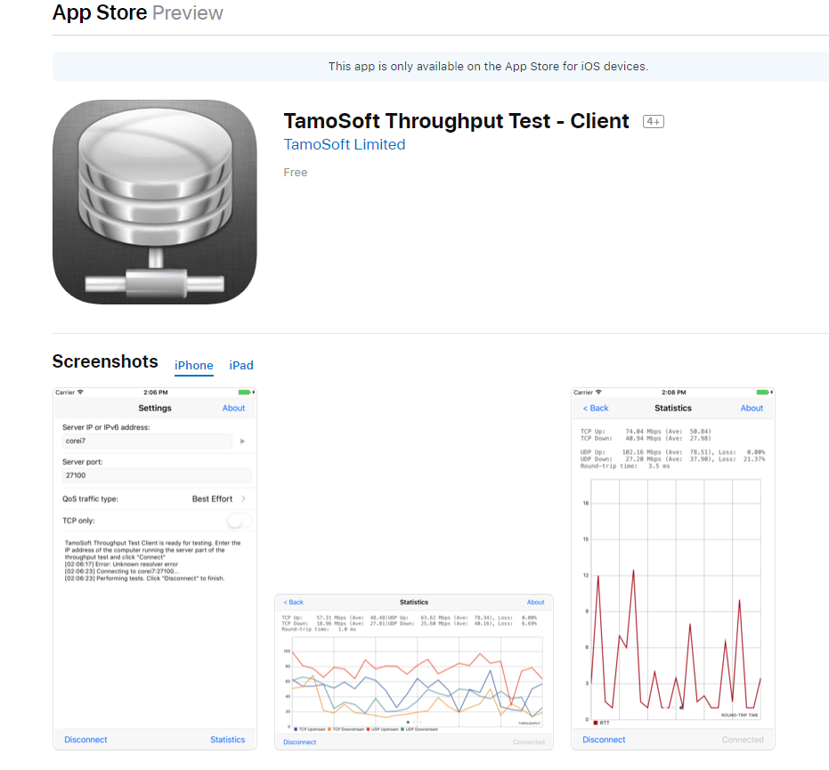
Installing TT: Smartphones
If you have two PC’s, you can use TT client on one PC and TT server on another. However, chances are you won’t have two PC’s. The solution is to download and run an Android or iPhone iOS TT client. Navigate your phone to Google Play Store or Apple App Store, download and install the Throughput Test client (From Google Play store) / TamoSoft Throughput Test-Client (from Apple AppStore).
Search Google Play Store for Tamosoft Throughput Test
Search Apple AppStore for Tamosoft Throughput Test
Notes:
http://www.tamos.com/docs/tt1.pdf

Slide 21
Details about TT
During each testing cycle, Tamosoft performs several tests: sending and receiving TCP data, sending and receiving UDP data, and sending and receiving a time probe packet. Based on these tests, it computes TCP and UDP upstream and downstream throughput values (current, for the latest test, and averaged, for all tests), as well as the round-trip time. When all tasks in a cycle are completed, a new cycle automatically begins.
Throughput
Throughput is the speed of application-layer data sent from the client to the server (upstream) or from the server to the client (downstream). Remember, throughput is always less than the network rated speed (data rate) because throughput is measured at the application layer after accounting for all of the network and packet overhead.
Overhead
Overhead negatively impacts throughput and it comes in many forms. There is the overhead of packet headers, broadcast traffic overhead, interference overhead, encapsulation overhead, contention overhead and retransmission overhead. Retransmission overhead, which occurs when frames are corrupted or lost, is more common with Wi-Fi than it is with Ethernet because Wi-Fi uses a shared access protocol running over a radio medium while Ethernet uses a switched access protocol running over a copper or fiber-based medium.
As noted earlier, the Throughput to Data Rate Ratio is a measure of protocol efficiency. In most cases, we focus on downstream network performance. Therefore, when working with TT, use the following formula to calculate efficiency:
Efficiency = Average TCP Down divided by Data Rate

Slide 22
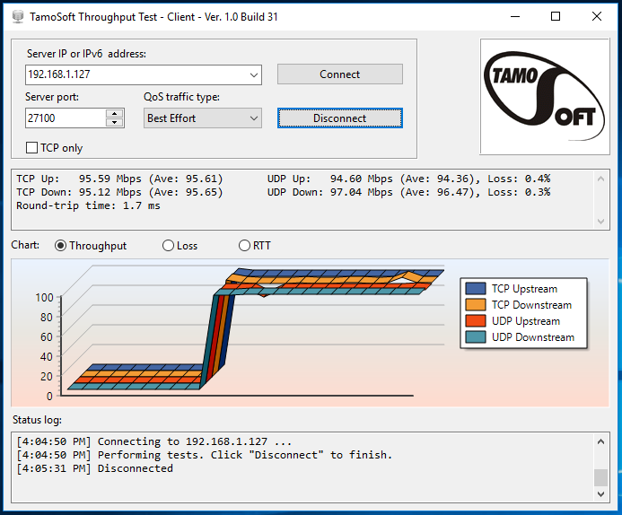
Ethernet Throughput Testing
One of the goals of this lab is to show you how the efficiency of Ethernet compares to the efficiency of Wi-Fi. Second, we want to show that Ethernet performance is more consistent over time, mostly because the media is more predictable. Since it’s unlikely that you will have 2 computer with Ethernet interfaces, we’ve provided some Ethernet performance test results for you.
The screenshot to the right shows a TT test conducted between two PC’s using 100 Mbps Fast Ethernet interfaces. Note the consistency of throughput as well as the low packet loss. Using data from this screenshot, calculate the network efficiency using the throughput to data rate ratio calculation presented previously.
Can you explain why UDP average downstream throughput is slightly higher than TCP downstream throughput?

Slide 23
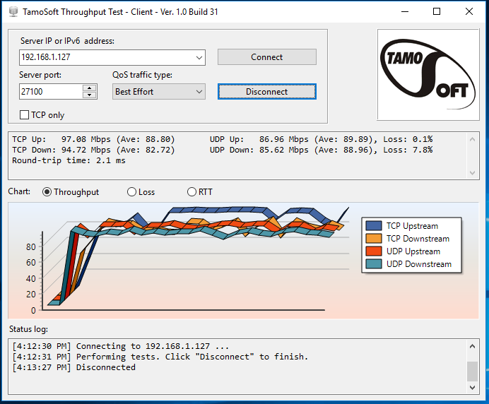
Wi-Fi to Ethernet Throughput Testing
The screenshot on this page shows a TT test conducted between two PC’s, one of which is connected to a 100 Mbps Fast Ethernet switch, the other client on Wi-Fi. Note that the throughput is not as consistent as the Ethernet-to-Ethernet test and the packet loss is much higher. Using data from this screenshot, calculate the network efficiency using the throughput to data rate ratio calculation presented previously.
Note the average speeds and packet loss.
Calculate TCP downstream throughput efficiency and compare
it to the earlier test.

Slide 24
Running TT server
Now, it’s your turn to run TT on your own lab testbed using your PC as a TT server and your phone as a TT client. You will be testing throughput over Wi-Fi. In most cases, both the PC and phone will be on Wi-Fi. However, if you are able to connect your PC via Ethernet, you should run that test as well.
Launch the TT Server application on your PC connected your network, likely over Wi-Fi.
Go to C://Program Files(x86)/TamoSoft/TT Server
You may be prompted for the administrator password for your system.
Please refer to the big TV screen ahead for the same.

Slide 25
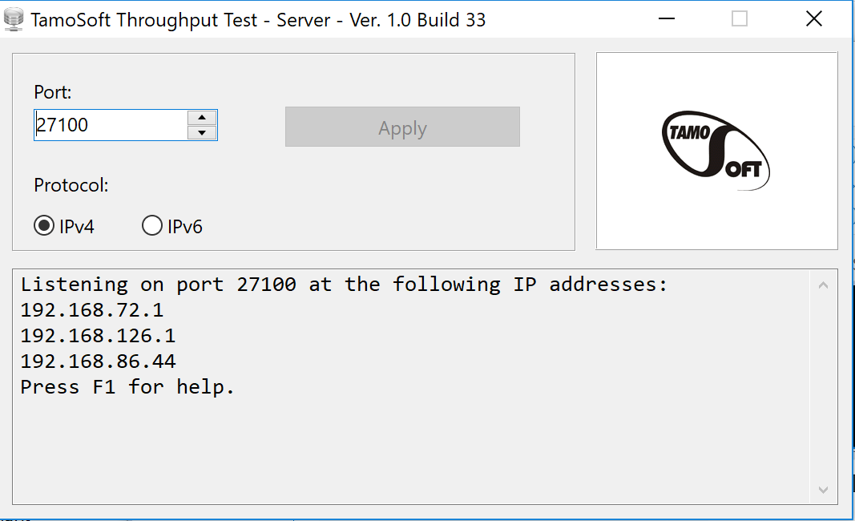
Running TT server
You should see an interface similar to the following:
In the lower pane, you’ll probably only see a single IP address. This is the address you will use when you set up the TT client on your phone. If you see multiple IP Addresses you will need to enter each one of them in TT Client.
Also, note that the TT server is running and listening for incoming connections by default on Port 27100. You can accept the default.

Slide 26
Preparing to Run a TT test
You will be testing Wi-Fi throughput between your smartphone and your PC, comparing the efficiency to TT results we have already shown you for Ethernet. This is a pure Wi-Fi test, both computers are connected to the same Wi-Fi network.
Your PC will be the TT server. As noted earlier, the server can connect to the network over Ethernet or Wi-Fi, you should try both options if it is convenient but we will focus on Wi-Fi in this exercise. Your smartphone also needs to be is connected via Wi-Fi. You may need to disable 4G first, you may also need to configure Wi-Fi parameters on your phone for the AP you are using if you haven’t set up such a connection previously. If you haven’t done this before, you should. Smartphone Wi-Fi performance usually exceeds smartphone 4G performance and it can be cheaper as well if you don’t have an unlimited data plan for your phone.
Since you will be calculating efficiency, you need to know the data rate of your Wi-Fi connections. When your PC connects to your wireless router, it negotiates a data rate that is appropriate in light of the quality of wireless signals. The data rate will be lower if your radio signal levels are lower. In order to find the data rate on your computer follow steps on the next slide.

Slide 27
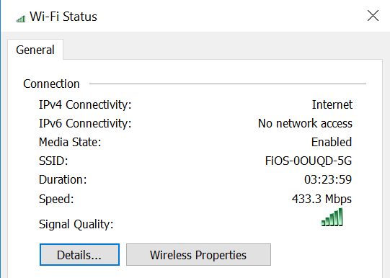
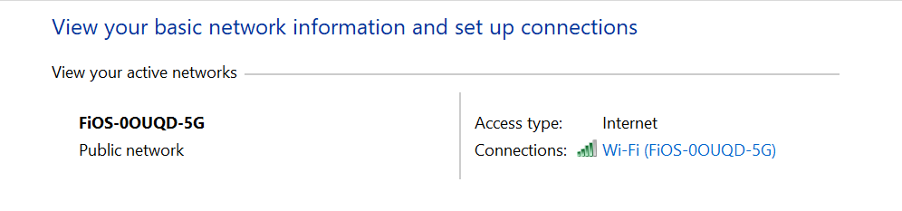
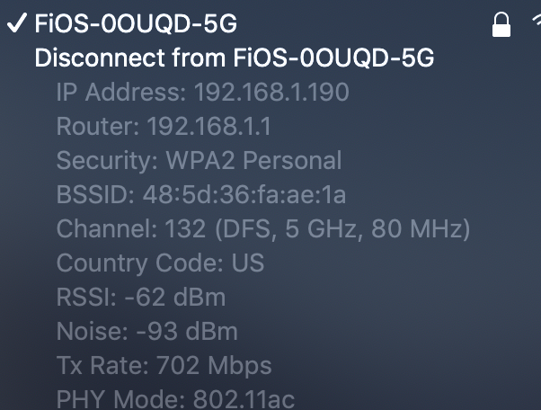
Preparing to Run a TT test
Windows:
From the Start Menu, go to Control Panel, click Network and Internet. If you don’t see it, go to the next step.
From the available options click Network and Sharing Center.
You will see the Access Type as Internet and its name in the corresponding Connections field, along with the Signal Strength. Click on the name to see the Data Rate.
Note the Data Rate displayed in the Speed field.
Mac:
Press and hold the ‘option’ key on your keyboard and simultaneously click on the WiFi symbol in your taskbar and note the Tx Rate.

Slide 28
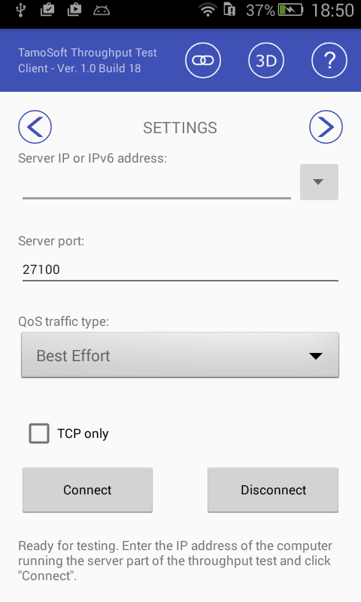
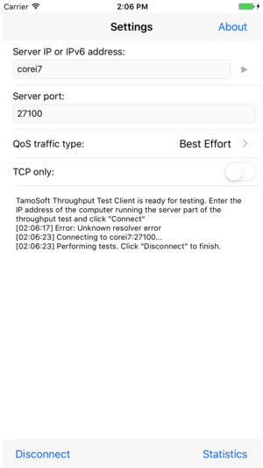
Running TT client
Verify that your smartphone is connected via Wi-Fi. Ping it from your PC to verify.
Run the TT client on your phone.
Enter the IP address for the TT Server running on your PC.
By default, your client will connect to the TT server using port 27100. Since we didn’t change this on the server, we’re good to go.
Before connecting, take note of two other options. By default, TT runs both TCP and UDP throughput tests, but you can override that and just run TCP. Second, TT can use Network QoS to prioritize traffic. We’ll just be using Best Effort, no prioritization.
Press Connect to start, Disconnect to Stop.

Slide 29
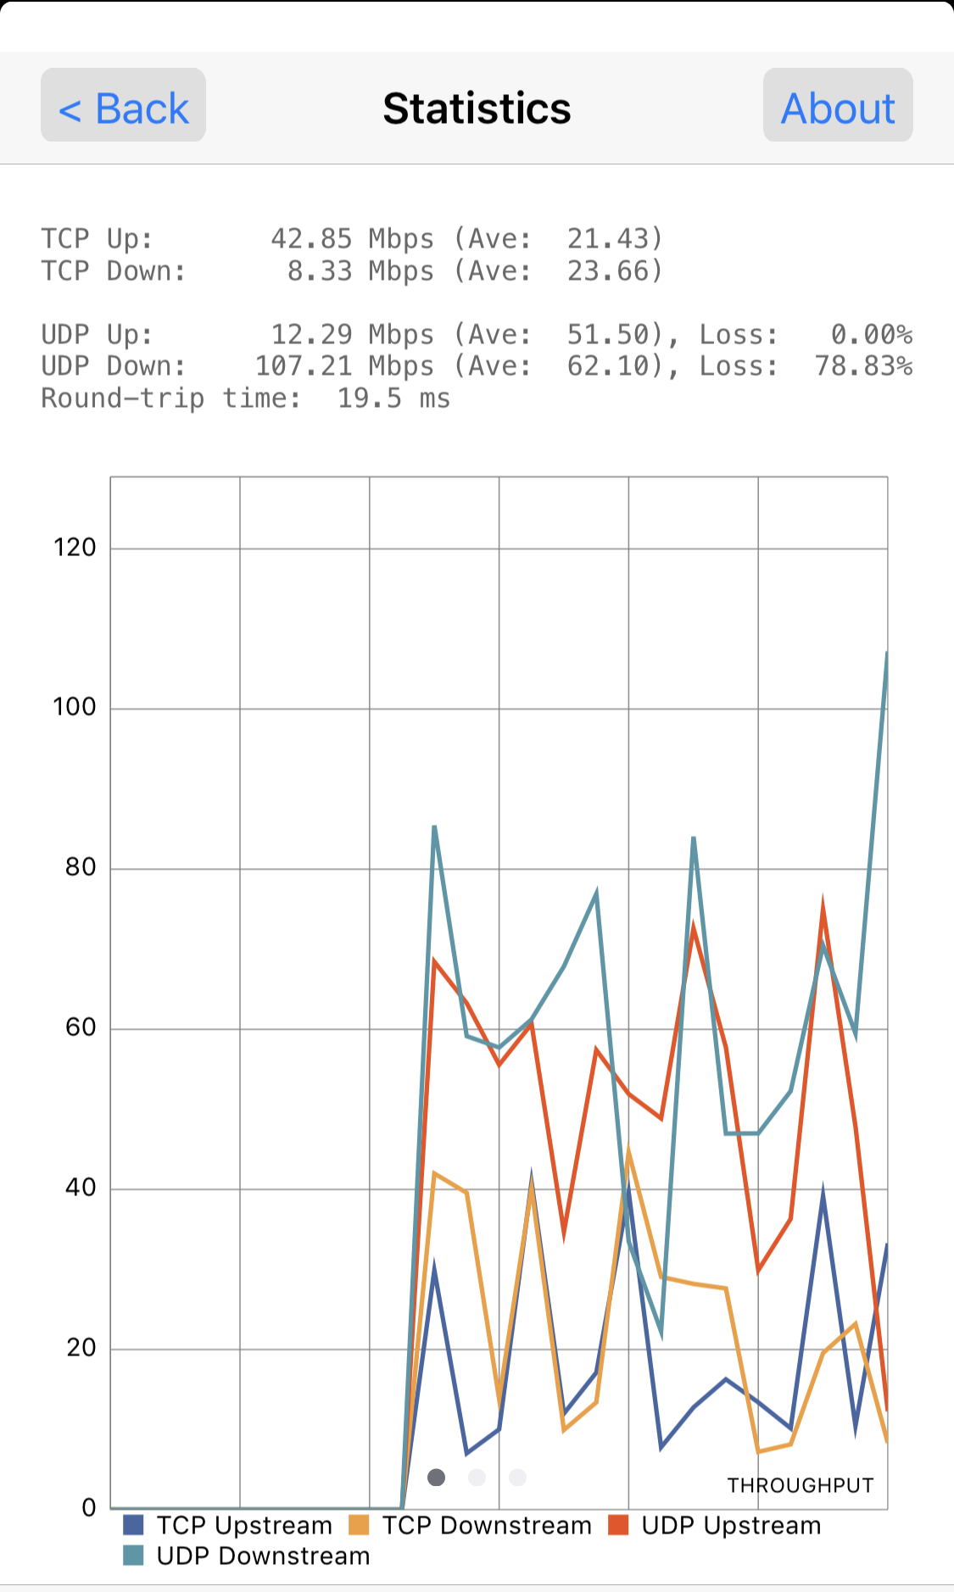
WiFi server and WiFi client
Now, compare your results of running TT on your phone to the screenshots in slide 22 and 23.
Note: The results in the screenshot to the right will likely be significantly different than your tests. That’s because Wi-Fi signals are so variable in nature. You can prove that by repeating the test in a different location. Even tests performed at the exact same location will likely vary. That’s why network engineers refer to wireless as a probabilistic media and Ethernet as a deterministic media.

Slide 30
Lab Check #3
Explain two differences between a Wi-Fi connection and an ethernet connection based on today’s exercises.

